Slide 1
CASE STUDY DEMO
By: Ömer Faruk AKGEYİK

Slide 2
CONTENTS
Introduction
Framework Overview
Page Object Model (POM)
Key Folders
Dynamic Configuration
Live Demo
Execute a Test
Show Report Generation
Simulate a Failure
Key Strengths
Conclusion & Future Improvements
Closing
Final Tips

Slide 3
INTRODUCTION
The goal of this framework is to ensure robust, maintainable, and scalable test automation while adhering to industry best practices like the DRY principle and config-driven testing

Slide 4
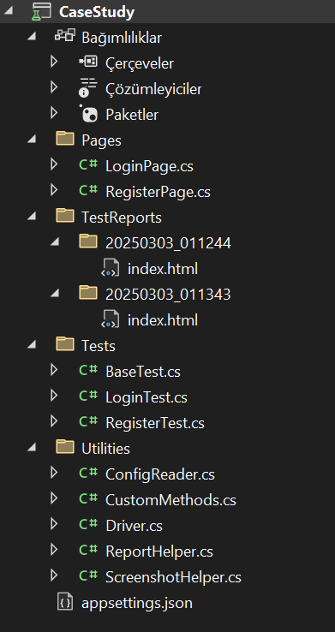
FRAMEWORK OVERVIEW Page Object Model (POM)
Why POM?
Separation of Concerns: UI locators (e.g., LoginPage.cs) are isolated from test logic (e.g., LoginTest.cs).
Reusability: Methods like Login() or Register() can be reused across multiple test scenarios.
Maintainability: Changes to the UI require updates only in the relevant page class, not across all tests.

Slide 5
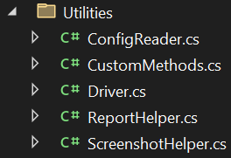

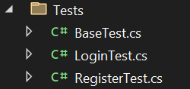
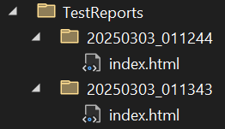
FRAMEWORK OVERVIEW Key Folders
Pages: LoginPage.cs and RegisterPage.cs define WebElements and actions (e.g., entering credentials, clicking buttons).
Utilities: Driver.cs (Singleton WebDriver), ConfigReader.cs (dynamic data), ReportHelper.cs (ExtentReports integration).
Tests: LoginTest.cs and RegisterTest.cs contain test steps, while BaseTest.cs handles setup/teardown.
TestReports: Timestamped HTML reports with screenshots for debugging.

Slide 6
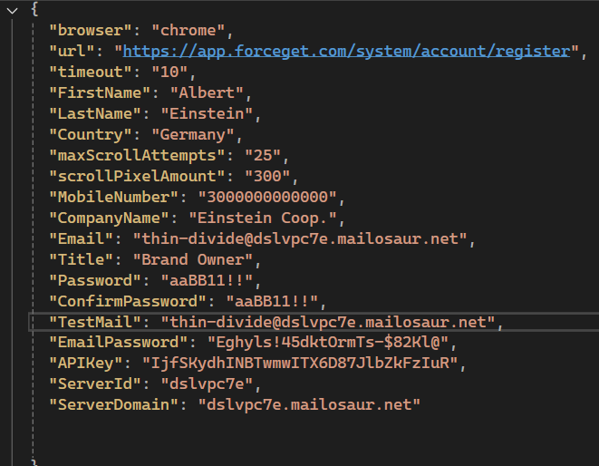
FRAMEWORK OVERIEW Dynamic Configuration
appsettings.json:
Stores test data (e.g., credentials, OTP API keys) to avoid hardcoding.

Slide 7

LIVE DEMO

Slide 8
Key Strengths
DRY Compliance:
Reusable methods like EnterText() and WaitForElement() in CustomMethods.cs.
ExtentReports Integration:
Professional HTML reports with historical tracking.
Singleton WebDriver:
Efficient resource management with Driver.cs.
Scalability:
Easy to add new pages (e.g., DashboardPage.cs) or tests (e.g., PasswordResetTest.cs).

Slide 9
Conclusion & Future Improvements
Closing
This framework demonstrates a balance between maintainability, scalability, and readability. It’s designed to evolve whether adding new features or integrating with CI/CD pipelines like Jenkins.
Future Goals
Parallel test execution.
Cloud testing (e.g., BrowserStack).
API testing integration.

